Slide 1
Mediterranean Trip 2024
Brandon Pennington: bpenning@wwayne.k12.in.us
June 10, 2024 – June 20, 2024
Please sign in with your names and email addresses

Slide 2
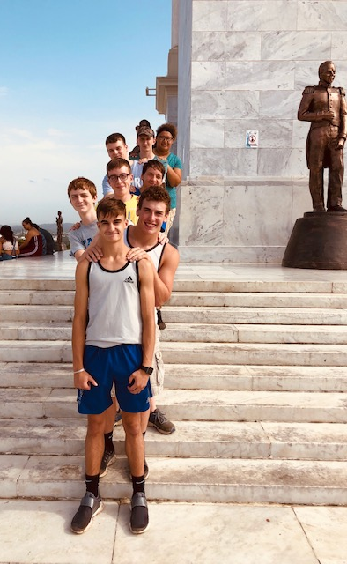
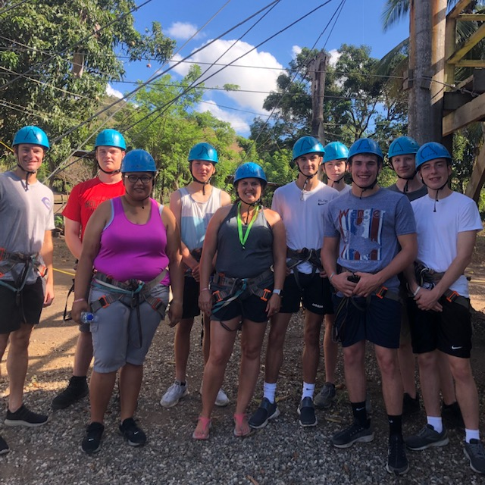
LHS Travel Club
Trips
Italy and Greece 2013
Brookville Canoe trip 2013
Costa Rica 2015
Dublin, London, Paris 2017
Dominican Republic 2019
Germany, Switzerland, Austria 2022

Slide 3
Why should you travel?
Expanded world view
Understanding and appreciation of different cultures
First-hand experience of classroom lessons
Personal growth
Increased confidence and competence
Language and cultural immersion
Marketable experience
Demonstrates maturity and worldliness
Enhances college and job applications
Notes:
International travel is a transformative experience. Visiting the places you’ve learned about in school and interacting with people from different cultures provides a whole new worldview. You’ll gain confidence and maturity as you converse in a different language, try different foods and actually experience the places you’ve seen in movies.
You’ll be transformed from a traveler into a true global citizen--a respected credential for college applications and a marketable trait that opens doors for the rest of your life.

Slide 4
Why Explorica?
Proven experience
Over 15 years in student travel
More than 1 million travelers
Tours to 75 countries on all 7 continents
Excellent value
Fully inclusive
Quality hotels, meals & activities
Guaranteed best prices
Incredible tour directors
Professionally trained
Specialized in student travel
Local experts
With group 24/7
Exceptional safety record
Proven systems in place at all levels of operations
Unmatched in industry
Notes:
Explorica has been leading student tours for more than 15 years. They’ve helped over a million students and their teachers experience more than 75 countries on all seven continents.
This means they can get quality tour components—hotels, meals and activities—for a great price. In fact, they guarantee the best prices in the industry. And they include everything upfront, so there are no hidden costs later.
But price is only half the picture. What sets Explorica apart is their tour directors. When we travel we’ll get an expert tour director who will act as our host, our logistic coordinator, our translator, our go-to local expert, guiding us every step of the way while bringing the destinations to life. Explorica tour directors are the best in the business, and they’ll help us truly experience the local culture.
Explorica also has an excellent safety record, with industry-leading risk management protocols built into every aspect of their operations. Here’s how they provide total peace of mind… (switch to next slide)

Slide 5
Why Explorica?
Safety above all else
Proactive risk management
Expertly trained, multilingual tour directors
24/7 emergency support
Daily tour updates
Global vigilance
Network of more than 45 offices around the world
USTOA $1 million Travelers’ Assistance
Comprehensive liability coverage
Trusted travel protection plans
Notes:
Safety is, and always has been, Explorica’s top priority. They take a proactive approach to risk management that ranges from rigorous safety checks and detailed site visits, to continual safety trainings for their staff.
Our tour director will be with us 24/7 and they will post an update about our tour to a private trip log each evening. Behind the scenes, Explorica has a risk management team that’s continually monitoring conditions around the world. Their emergency support line is always on call, and their extensive network of offices means that they are always nearby to help in person if the need arises.
Explorica is a member of the United States Tour Operator’s Association, so your trip investment is protected by USTOA’s $1 Million Travelers’ Assistance Program, and Explorica even provides optional travel protection plans for cancellations and any other unforeseen circumstance. I’ll cover those later.
The bottom line is that Explorica has been an educational travel industry leader since 2000, so they have the experience, resources and coverage we need for a safe and worry-free trip.

Slide 6
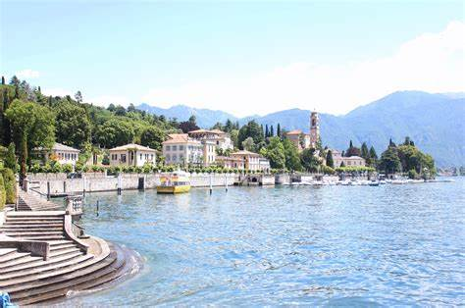
Highlights
Mt. Titlis Excursion
Free Day at Lake Como, Italy
Cinque Terre
Monaco

Slide 7
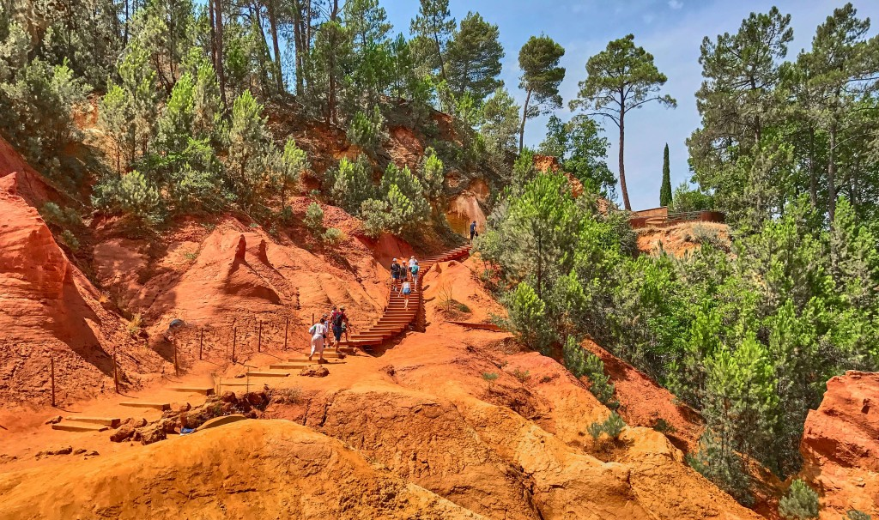
Highlights
Nice, France
Hiking the Ochre Trail in Provence
Las Ramblas, Barcelona
Paella

Slide 8
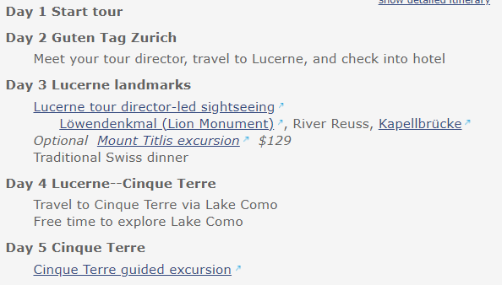
Where we’re going
Tour itinerary

Slide 9
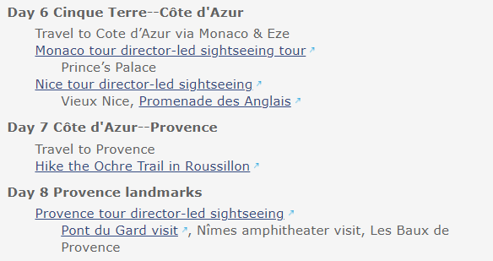
Where we’re going

Slide 10
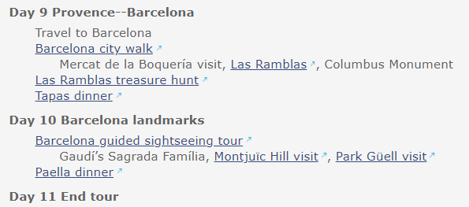
Where we’re going

Slide 11
Online tour diary
Notes:
When we travel we will have our own online Tour Diary, a private trip log that our tour director will update each evening. This is a sample from a real tour, so you can see the format. It provides a way for friends and family to check in on us every day, and see the incredible places we’ll be experiencing!

Slide 12
All-inclusive tour
Everything you need for a great trip!
Round-trip airfare
All on-tour transportation
Accommodation in triple or quad rooms with private bathrooms
Full breakfast daily
Hearty, authentic dinner daily
On-Tour Tipping
Entrance fees to attractions per itinerary
Guided sightseeing tours and city walks per itinerary
Full-time, professional Tour Director
Online Tour Diary™
24-hour emergency service
To consider
These costs vary by tour and traveler, so we do not include them:
Passport and visa
Snacks or beverages
Souvenirs
Free-time activities
Notes:
Explorica doesn’t believe in nickel-and-diming people once they’re on tour, so all their trips—including ours—are fully inclusive, providing everything we need for a remarkable experience: Flights, hotels, breakfasts and dinners, transportation in and around our destinations, entrance fees to attractions, guided sightseeing tours and more. And of course, all the industry-leading safety measures I talked about earlier are also included.
They even remind you about general travel costs, like tipping or the fee for obtaining a passport, so you’re prepared for what to expect.

Slide 13
Accreditation
Academic credit
Complete assignments before, during and/or after your tour
Earn high school and/or college prep credits for your travel experience!
Notes:
Explorica is an accredited institution just like our school, which means students can earn academic credit for qualified tours. It’s a great way to make the most of your travel experience while also enhancing your resume and accelerating your education.
Talk to me later if you’d like to take advantage of this opportunity!

Slide 14
Pricing
Student (22 & under)Trip
$4,150 (for 30 or more)
$4,043 (for 40 or more)
This includes a $200 early bird discount
Use code Travel0P
That is a zero above, not a letter
This code ends Nov. 10th
Adult Trip
Add $530
Returning travelers
Anyone who went to London, Dublin, Paris or the DR trip, or Germany trip
$100 additional discount!
Use your login info from the previous trip
Call 1-800-310-7121 if you have forgotten
Notes:
Explorica is committed to making their tours attainable, so they do a couple of really helpful things that you can take advantage of:
They provide every traveler a personal fundraising page on explorica.com, enabling you to raise money for your trip using social media.
They offer need-based financial assistance, and you can find out if you qualify with one simple phone call.
And they offer payment plans that let you break up your tour fee into multiple installments. There are two options:
The automatic payment plan is the easiest, spreading out your payments over the months leading up to your tour. With this option, you only need $50 to sign up.
Or if you prefer manual payments, you can put down a $99 deposit then pay the remaining balance in four installments.
Details on each plan and financial assistance can be found in your trip invitation letter.

Slide 15
Easy ways to pay
Fundraising support
Personal fundraising page on explorica.com
Easily request and accept credit card donations from friends and family
Support letter provided by Mr. Pennington
Financial assistance
Need-based support for qualifying families
Confidential application
Automatic monthly payment plan
$50 deposit paid upon registration
Balance divided into equal monthly installments
Payments charged automatically
Manual payment plan
$99 deposit paid upon registration
Balance divided into 4 installments
Payments rendered manually
Notes:
Explorica is committed to making their tours attainable, so they do a couple of really helpful things that you can take advantage of:
They provide every traveler a personal fundraising page on explorica.com, enabling you to raise money for your trip using social media.
They offer need-based financial assistance, and you can find out if you qualify with one simple phone call.
And they offer payment plans that let you break up your tour fee into multiple installments. There are two options:
The automatic payment plan is the easiest, spreading out your payments over the months leading up to your tour. With this option, you only need $50 to sign up.
Or if you prefer manual payments, you can put down a $99 deposit then pay the remaining balance in four installments.
Details on each plan and financial assistance can be found in your trip invitation letter.

Slide 16
Travel protection with TripMate
Travel Protection Plan
Lost tickets, passport, luggage, etc.
Sickness or injury on tour
And more
Travel Protection Plan PLUS
Everything in the standard plan
Plus exclusive Cancel for Any Reason protection
Notes:
So, what happens if you have to cancel? No one wants to miss the trip of their dreams, but sometimes life happens. Explorica has two plans through TripMate that help you protect your investment, both of which provide a cash refund.
The standard plan covers common mishaps
And the upgraded plan adds the ability to cancel your tour for any reason up to 30 days before departure. It’s the only such “cancel for any reason” policy in the industry, and it’s a really great assurance.
Both plans are optional, but just know that they’re available to you if you’d like to purchase insurance.

Slide 17
How to enroll
Online
www.explorica.com/Pennington-344
By phone
1.888.310.7121
By mail
Complete the paper application and return by mail
Notes:
I sincerely hope that you’ll be able to join me for this once-in-a-lifetime trip, and I encourage you to sign up early to give yourself the most time to pay and prepare. Signing up is easy, and you can do it online, by phone or by mail. You just need our Tour Center ID, which is in your invitation letter.

Slide 18
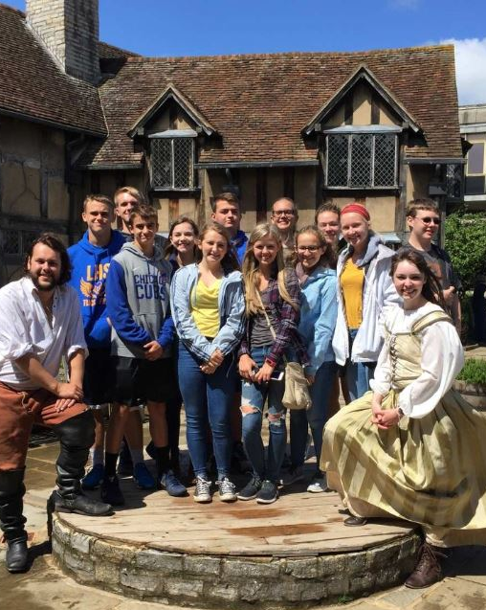
Join us!
Don’t miss your chance to:
Explore exciting destinations
Create lifelong memories and friends
Grow and mature as a person
Prepare for a successful future
Register today!
www.explorica.com/Pennington-344
Notes:
Well guys, that could be you! Your friends, your memories, your trip of a lifetime.
If you want to see the world, grow as an individual and jumpstart your future a successful, global citizen I invite you to sign up!
How many of you feel that you’re about 85% likely to join the tour? Fantastic!

Slide 19
Facebook
Lincoln High School Travel Club
Follow us NOW!
Notes:
I sincerely hope that you’ll be able to join me for this once-in-a-lifetime trip, and I encourage you to sign up early to give yourself the most time to pay and prepare. Signing up is easy, and you can do it online, by phone or by mail. You just need our Tour Center ID, which is in your invitation letter.

Slide 20
Questions?
Switzerland & the Mediterranean
bpenning@wwayne.k12.in.us
www.penningtonhistory.weebly.com then click on LHS Travel Club
Notes:
That concludes our meeting! If you need to head out, please ensure that I have your contact info so that I can send any updates and I’ll stick around for any questions. Thank you all so much for coming!

