Slide 1
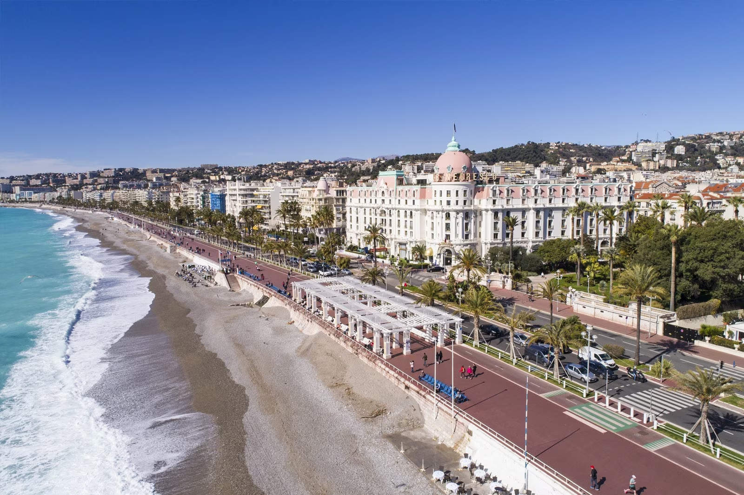
Switzerland the Mediterranean
Know Before You Go!

Slide 2
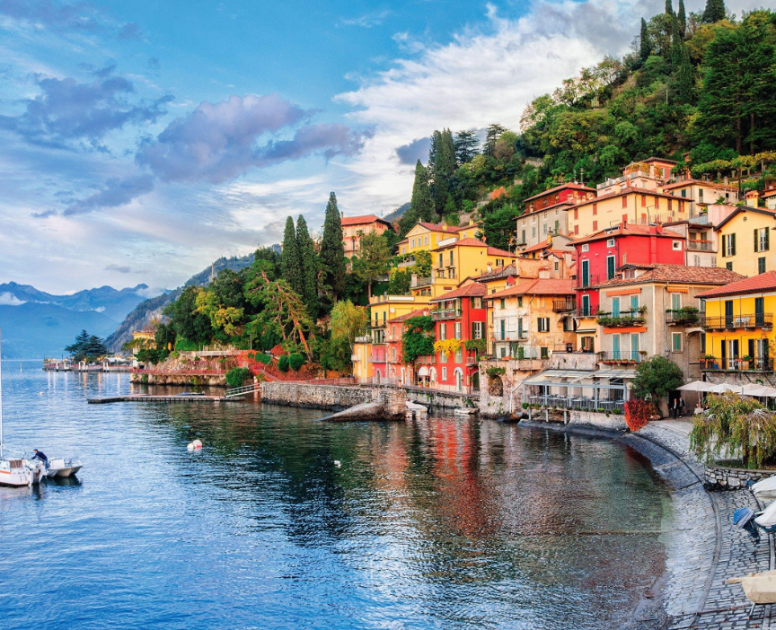

Fast Facts
Population:
Over 740 million people
Official Languages:
There are 24 official languages in Europe
  We will encounter French, German, Italian, and Spanish
Fun Fact:
Europe was named after Europa, in Greek mythology she was a Phoenician princess and one of Zeus’ lovers.
Portugal is the oldest country in Europe. Its borders were officially defined around 1139.
Europe contains the world’s largest and smallest countries:
  Russia is the largest with 6.6 million square miles.
  Vatican City is the smallest, located entirely within the city of Rome (.2 square miles).

Slide 3
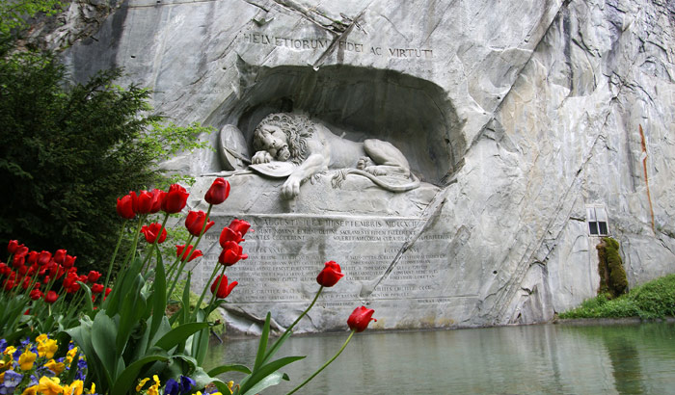
Culture
General
Europe is made up of many different countries, each with their own histories, traditions and culture.
Art, literature, music, architecture and film all have strong representations throughout Europe.
Check Out
Look at our itinerary ahead of time to get familiar with the locations and history

Slide 4
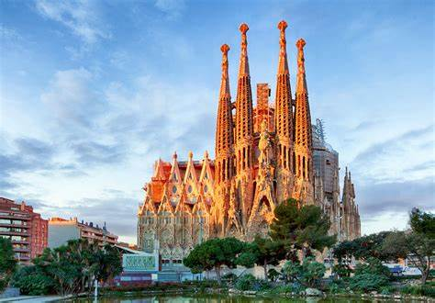
Language
Language
Europe if filled with many different languages. Here are just a few ways to say “Hello!”
  French – “Bonjour”
  Spanish – “Hola”
  German – “Hallo”
  Italian – “Ciao”

Slide 5
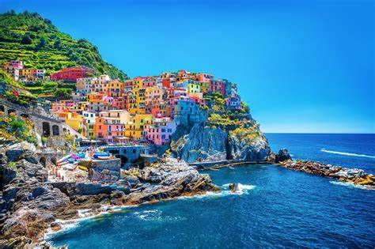
Climate
Europe covers many different climates ranging from Iceland which sits outside the arctic circle to Greece’s Mediterranean climate.
Summer Season
Typically the most popular time to travel around Europe.
Tends to be warmer.
Precipitation is possible, but not typically a cornerstone of the season

Slide 6
Your responsibilities
Entry
requirements
Travel to and
from the airport
Local currency
& tipping
Spending
money

Slide 7
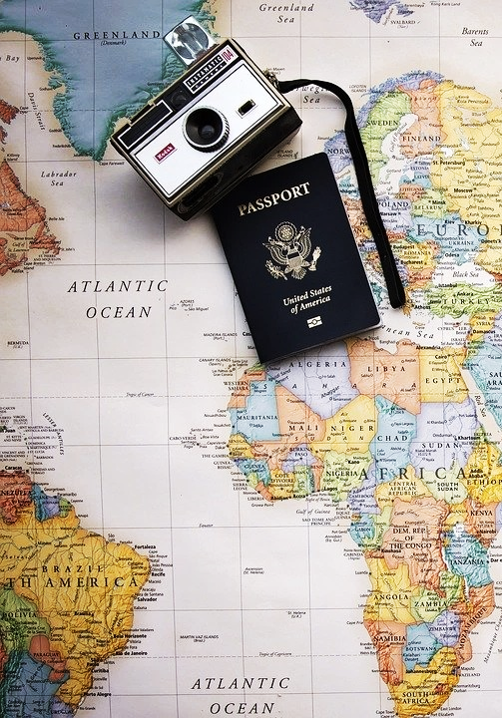
Entry Requirements
All travelers are responsible for securing the necessary documentation for travel. These pieces of documentation may include a passport and visa.
Passports
The application process takes 6-8 weeks, so plan accordingly.
  Important note: Passports must be valid for at least 6 months after our scheduled return date
Visas
Since requirements vary for each nationality, we recommend all travelers verify the individual requirements for their nationality with the local consulate for all the countries to be visited, or VisaCentral, Explorica’s partner for travel visas.

Slide 8
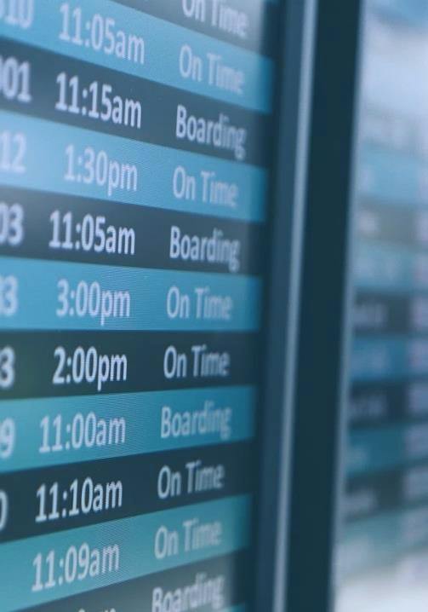

Getting to the airport
Individuals are responsible for travel to and from the airport, for departure and arrival back home.
When to get there
Arrive at the Indianapolis airport at 1:30 pm for a 3:59 pm flight
We will meet at the American counter inside the airport
Don’t be late!
International flights
Some food is provided but bring snacks
Hoody or jackets are a good idea as flights usually are cold
Bring motion sickness medication
On the way home
Make sure you have a pickup arranged
Return flight arrives in Indy at 6:39pm on June 20th
Baggage
Checked bags need to be under 50 lbs.
Fees will apply for more
Personal bag and carry-ons are permitted (pick ONE)

Slide 9
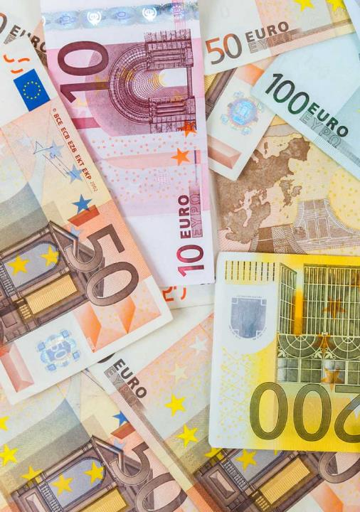

Local currency & tipping
Guidelines and expectations
Many countries except the Euro, but please make sure you check the local currency for all of your destinations!
For live exchange rates, check websites like xe.com or apps like XE Currency.
Currency
Switzerland: Swiss Franc
Italy, France, and Spain: Euro
Tipping Rates
We have pre-paid our tipping. I will pay any additional tips

Slide 10


Spending money
Recommended methods and estimated costs
Preparing money for your trip
Contact your bank before traveling. Let them know where & when you will be traveling. Be sure to check with your bank and credit card issuer to see what fees, if any, will be charged for overseas transactions.
Withdraw cash only as you need it. Cash is widely accepted throughout the country. Have enough for the first day or two and then utilize available ATMs. Also note that you will need a passport to exchange currency.
MasterCard and Visa are the most widely accepted credit cards in Europe, followed by American Express. Most hotels and restaurants accept all of these, especially in tourist destination areas.
Did you know?
The Euro was first introduced in 1999 but bank notes and coins weren’t introduced until 2002.
There are 19 countries that accept the Euro but there are 27 countries in the European Union.
Euro coins are different from country to country but the bank note is universal.
Spending money
We recommend that that each participant budget $30-$50 each day for souvenirs, free time transportation, and meals or drinks not included in the tour fee.

Slide 11
What to pack
Temperatures in the summer vary from Mid-70’s to the lower 90s but rain is common so always have a raincoat and appropriate layers.
Pack a formal outfit
  Many religious sites require a conservative dress code. Be sure to pack a light sweater and long pants or skirt. Often, one of the dinners has been a time to dress a little nicer.
Bring travel-sized toiletries
  Bring your shampoo and other toiletries in smaller sizes to reduce space and weight, in your luggage. Bring sunscreen.
Pack all important items in your carry-on
  Pack your passport and travel documents, money, debit cards medications (IN ORIGINAL PACKAGING), and a change of clothes in your carry-on, just in case your checked luggage is misplaced.
Other helpful packing ideas
Bring zip lock baggies, wipes, vacuum bags for dirty clothes, snacks, phone chargers, comfortable shoes, small first aide items, dryer sheets
Make your luggage stand out
  Use your Explorica luggage tag, and tie a brightly colored ribbon to the handle to make it easy to pick out at baggage claim.

Slide 12
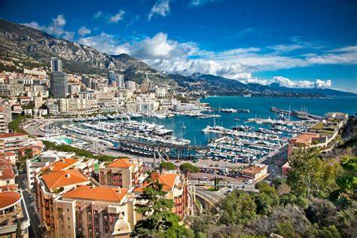
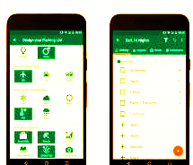
Packing
Clothing
Pack a variety of comfortable, casual clothing, with lightweight clothing for the summer. We will see some cooler temps in Switzerland. Italy, France and Spain will be warm.
Other Odds & Ends
Towel
First Aid supplies
Money belt for important documents/money
Camera & phone chargers
Sunscreen
Insect Repellant
Passport & visa photocopies
ATM/Debit/Credit cards
Helpful Packing Apps
Packr
PackPoint
Packing Pro
Travel List App

Slide 13
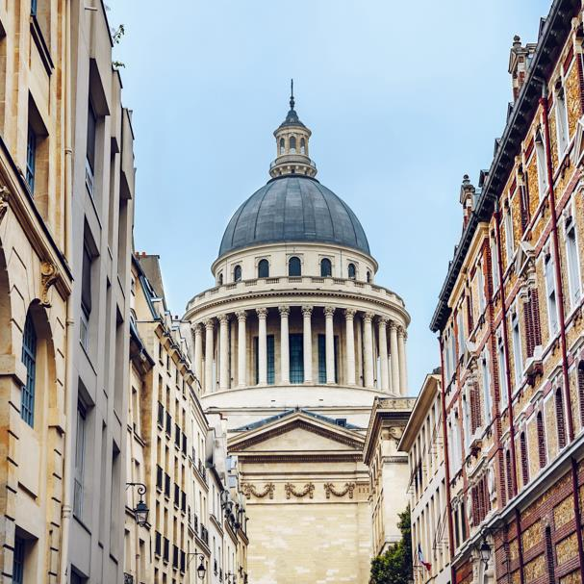
Travel Tips
Health
It’s a good idea to bring snacks along for long days on tour. Be sure to avoid dehydration during heavy periods of heat or activity. Drink lots of water!
Clothing
Dress comfortably with layers. If visiting a religious site, make sure knees and shoulders are covered. Bring long sleeves for cooler evenings and plenty of comfortable, breathable clothes for hot days. You won’t want to carry a lot with you, so remember that items you can layer are key.
Footwear
Bring comfortable shoes. You will be walking a lot everyday!
Electricity
Europe uses different voltages as the US. US travelers will need a converter and an adaptor.
Escape Your Comfort Zone
Try local foods, immerse yourself in the culture, and meet the locals! By putting yourself out there, you’ll be able to experience the exciting and adventurous culture of Europe!

Slide 14
Safety tips on tour
Always use the buddy system
  Be responsible for a friend and vice versa
Don’t approach strangers
Keep valuables out of sight
Be alert and aware of your surroundings
Move quickly on and off public transportation
Ask me or our tour director questions if instructions are unclear
Be punctual
  Make sure you follow instructions and meet at the set time and location
Notes:
Safety tips for the group leader:
Travel with a first aid kit
Create an emergency phone tree including parents and school

Slide 15
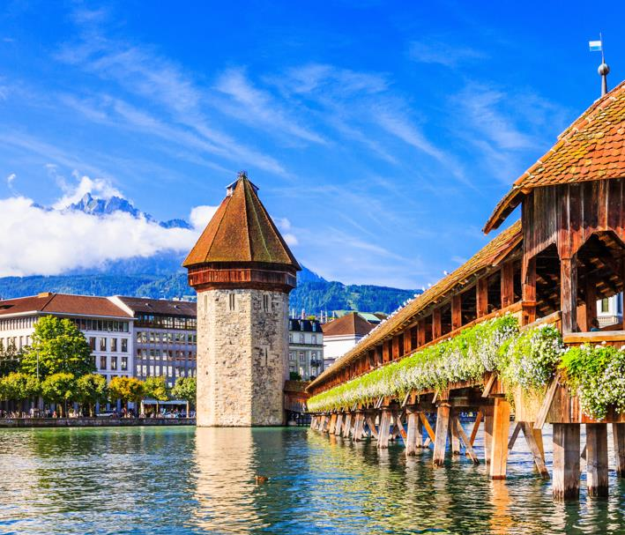
Staying in Touch
Cell Phone use
Remember to contact your service provider for information on international data plans.
Internet access
Wi-Fi will be available in most hotels, although connection may be slower than you are used to at home.
Keep in touch with Explorica
Email info@explorica.com
Customer Care (888) 310-7121
On-Tour Support (703) 933-6143
*This line is ONLY to be used while traveling in the
event of a flight delay or an issue on tour.

Slide 16
Cell Phone Usage
Contact your cell phone service provider
  Find out what international plans are offered before your trip and avoid international overage fees.
  Use Wi-Fi for all iPhone texts and Facetime
  Turn off Cellular Data to avoid roaming and international charges
  Use airplane mode to avoid charges
Wi-Fi will be available at all hotels and many downtown areas.
Use calling apps such as Skype and WhatsApp
Notes:
The goal of this tour is to become immersed in the local culture. Personal cell phone use can be expensive and should be kept to a minimum.

